Slide 1
Office of the Right Eminent Grand Recorder
Grand Encampment Office
5909 West Loop South
Suite 495
Bellaire, Texas 77401

Slide 2
Office of the Right Eminent Grand Recorder
713-349-8700 TELEPHONE
713-349-8710 FACSIMILE
larry@gektusa.org

Slide 3
Office of the Right Eminent Grand Recorder

Slide 4
Office of the Right Eminent Grand Recorder

Slide 5
Office of the Right Eminent Grand Recorder
Grand Encampment Membership Award

Slide 6
Office of the Right Eminent Grand Recorder
Effective September 1, 1991
First line signer – 10 petitioners
Knighted or Restored to membership
Cumulative, 1991-present
Bronze, Silver or Gold Leaf Cluster

Slide 7
Office of the Right Eminent Grand Recorder
Original form to be completed by
Recorder of Constituent Commandery
Forwarded to Grand Recorder of
Grand Commandery for validation
Forwarded to Grand Encampment Office
for verification and issuance

Slide 8
Office of the Right Eminent Grand Recorder
Knights Templar Cross of Honor

Slide 9
Office of the Right Eminent Grand Recorder
Knights Templar Cross of Honor
Section 237(b)
One nomination from each Grand Commandery
plus
one additional nomination for each 5,000
members or major fraction thereof

Slide 10
Office of the Right Eminent Grand Recorder
A nomination for the award shall be made by the Commandery of which the nominee is a member, by a motion adopted by the Commandery
Must be submitted in writing on prescribed form and approved by the Grand Commander

Slide 11
Office of the Right Eminent Grand Recorder
Submitted to Grand Encampment Office
60 days prior to Grand Commandery Conclave
Requires Grand Master’s approval
Shipped to Grand Recorder
30 days prior to Grand Commandery Conclave

Slide 12
Office of the Right Eminent Grand Recorder
Grand Commandery
Annual Returns

Slide 13
Office of the Right Eminent Grand Recorder
Section 41
Grand Commandery
(h): It shall, on or before July 1st of each year pay to the Grand Recorder of the Grand Encampment such an amount as may be prescribed by the Grand Encampment as dues for each member of its
Constituent Commanderies, as shown by the returns of such Grand Commandery as of December 31st.
NOTE -- AMENDED 2015

Slide 14
Amendment No. 2015-05 ADOPTED 2015
Requires Grand Recorder to file Annual Returns on prescribed forms
Assesses $500 penalty for late, inaccurate or incomplete Annual Returns

Slide 15
Office of the Right Eminent Grand Recorder
Section 52
Grand Recorder
It is the duty of the Grand Recorder…
(b) To forward to the Grand Recorder of the Grand Encampment, on or before the First Day of July of each year, the Annual Returns and Dues of the Grand Commandery.
NOTE -- AMENDED 2015

Slide 16
Amendment No. 2015-04 ADOPTED 2015
Requires Grand Recorder to file Annual Returns on prescribed forms
Assesses $500 penalty for late, inaccurate or incomplete Annual Returns
Requires Grand Recorder to forward required forms within thirty (30) days
of Annual Conclave

Slide 17
Office of the Right Eminent Grand Recorder
Recapitulation (Reporting) Period
January 1 – December 31
Due in Grand Encampment Office
on or before July 1
NOTE -- PENALTY FOR LATE, INACCURATE OR INCOMPLETE RETURNS
Electronic Reporting will be implemented
when ALL Commanderies are using MMS

Slide 18
Office of the Right Eminent Grand Recorder
Knights Templar Eye Foundation
ASSESSMENT is part of your
Grand Commandery Returns to
Grand Encampment
DO NOT REMIT TO KTEF OFFICE
in Flower Mound, Texas

Slide 19
Office of the Right Eminent Grand Recorder
Grand Master Goodwin’s Decision No. 11:
RE: Orders, Address Changes, Status Changes, Deaths, etc.
Each Commandery Recorder and Grand Commandery Grand Recorder is responsible for entering information…within 15 days of the occurrence.

Slide 20
Office of the Right Eminent Grand Recorder
Welcome Letter from MEGM Vaught
Knighting Card
KTEF material
Bicentennial Malta Jewel

Slide 21
Amendment No. 2015-06 ADOPTED 2015
Requires Constituent (or Subordinate) Recorder to issue a Grand Encampment Dues Card to all Sir Knights of his Commandery
Bears Seal of the Grand Encampment and the Attestation of the Grand Recorder of the Grand Encampment

Slide 22
Office of the Right Eminent Grand Recorder
Grand Encampment Rituals
Can be ordered only by Grand Recorders
(multiples of 10)
May be shipped and billed to
Constituent Commanderies

Slide 23
Office of the Right Eminent Grand Recorder
College of Honors
Knight Commander of the Temple
Companion of the Temple
Knight Grand Cross of the Temple

Slide 24
Office of the Right Eminent Grand Recorder
ITEMS FOR SALE
THROUGH
GRAND RECORDER’S OFFICE

Slide 25
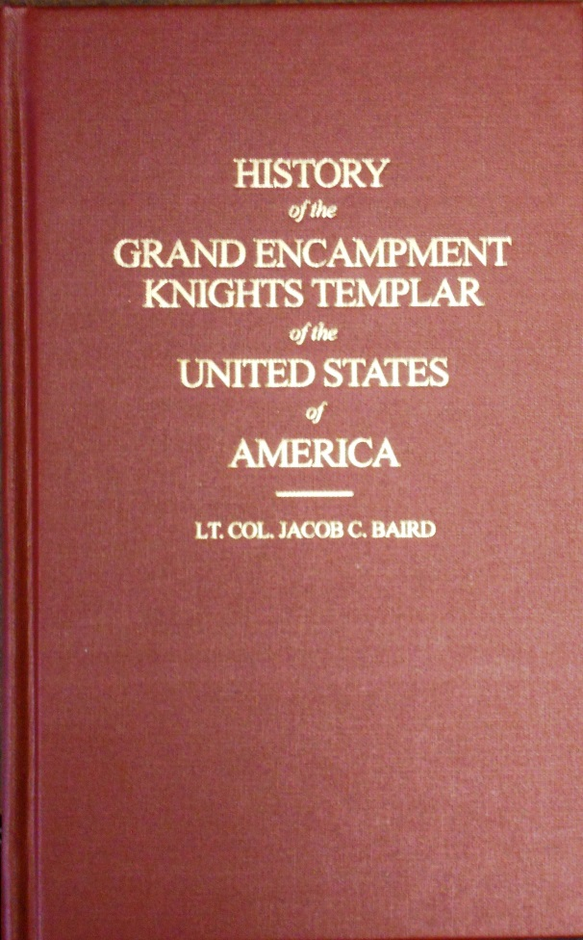

Slide 26
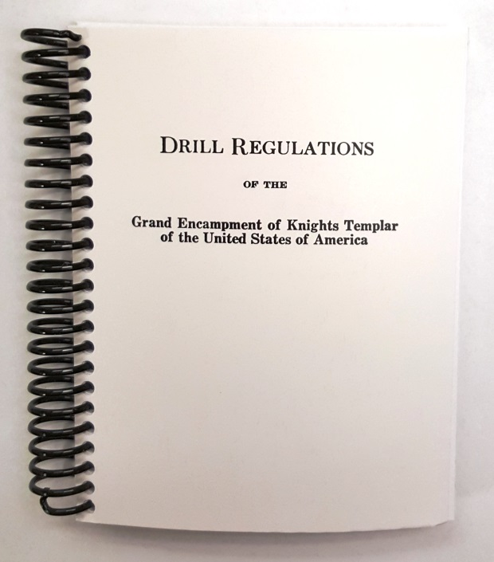
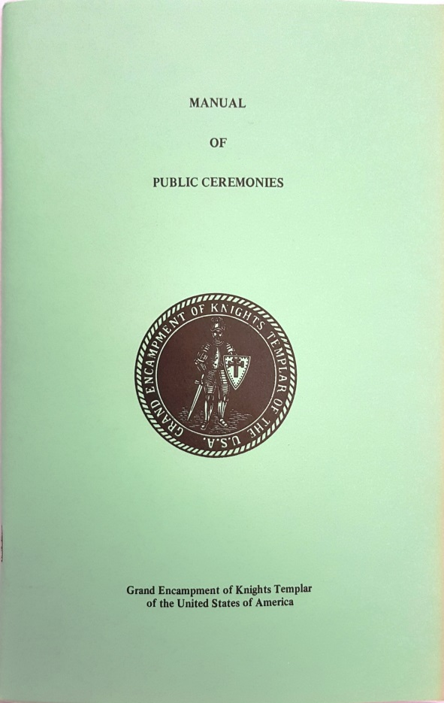
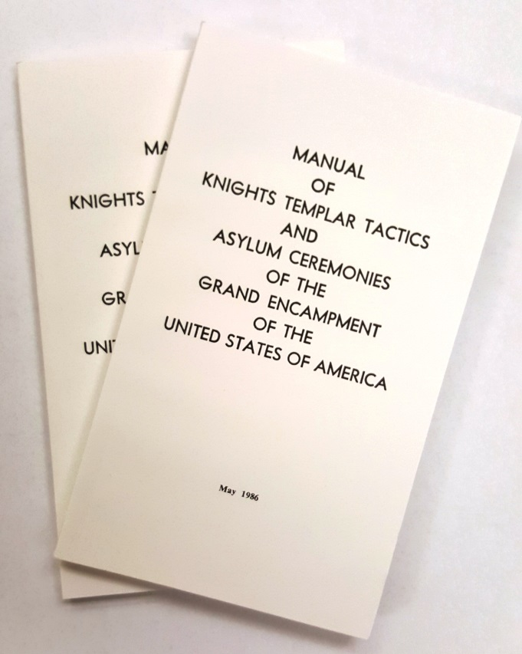

Slide 30
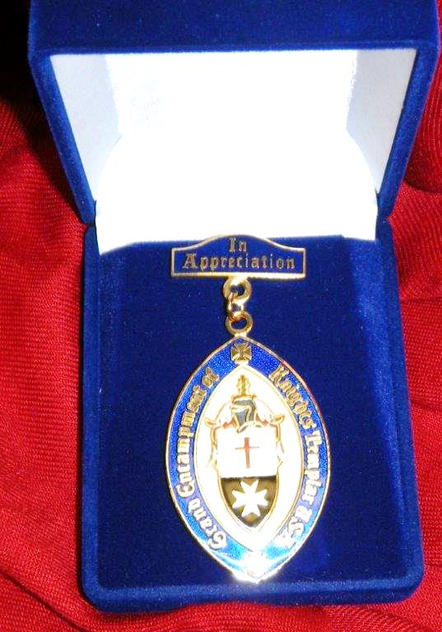

Slide 32
Office of the Right Eminent Grand Recorder
QUESTIONS?
COMMENTS OR CONCERNS

Slide 34
Office of the Right Eminent Grand Recorder

