Slide 1
Templar Law

Slide 2
Templar Law
What not to do as Grand Commander

Slide 3
Officers
Must a Grand Commandery Officer be a Past Commander?
Officers MUST be a member of the Grand Commandery
ie: Past Commander or Dais Officer
except Grand Prelate

Slide 4
Officers
Who is eligible to be a Grand Commandery Officer
Any member of the Grand Commandery

Slide 5
Grand Master Decision 8
Additional requirements for Templar office
Any member eligible for office under Grand Encampment Constitution is eligible for office
May not impose additional requirements or prohibitions

Slide 6
KTCH
Who is eligible for the Knight Templar Cross of Honor?
A Sir Knight who has never held elective office in a Grand Commandery

Slide 7
KTCH
How are nominations for the Knight Templar Cross of Honor made?
Nominated by the Commandery
Approved by Grand Commander

Slide 8
Jewels
Where may jewels be worn on the uniform?
Section 301. Only Templar Jewels are to be worn on the Templar Uniform. Jewels of office, meritorious jewels, badge of Commanderies, Malta and Red Cross jewel may be worn on the left breast, placed in the order named, from the wearer's right to left. (1985, p. 75-80)

Slide 9
ORDER OF JEWELS

Slide 10
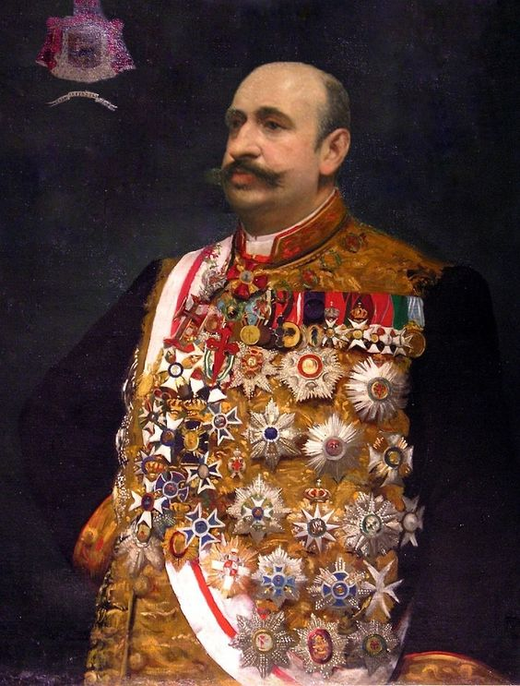

Slide 11
Jewels
What makes a Jewel a Templar Jewel?
Only Templar jewels may be worn on a Templar uniform and it is presumed that a Grand Commandery has ruled correctly on individual jewels unless found otherwise. A Drill Corps badge qualifies as a Templar Jewel. The authority of different Grand Commanderies to govern their jurisdictions permits differences to occur. (1925, p 73 & 402, No. 21, Newby)

Slide 12
Jewels
So the Grand Commandery can make any jewel official?
A Grand Commander is in error to request that Sir Knights wear Victory or Official Military Service Badges. (1937, p 28 & 327, No. 11, Agnew,)

Slide 13
Jewels
Did the Grand Commander in the prior slide do anything else?
A first prize medal awarded by Ohio State University is not a Templar Jewel. (1937, p 27 & 325, No. 9, Agnew)

Slide 14
Jewels
What can go on the right side of the uniform?
Name plate
Knight Templar Eye Foundation badge
Grand Encampment committee badge
Triennial badge (during the session)

Slide 15
Jewels
What jewels can go around the neck? KYCH?
The statutes provide that certain officers may wear a jewel suspended from a cord around the neck, but they do not provide for this kind of jewel. (KYCH) (1961, p. 50, No. 23, Wieber)

Slide 16
Jewels
What jewels can go around the neck?
Section 302. The Jewels of Office of the Grand Master and other current Officers of the Grand Encampment shall be worn suspended from a heavy royal purple silk cord with swivel

Slide 17
Jewels
What jewels can go around the neck?
Section 306. (a) The Jewel of Office of Grand Commanders may be worn suspended from a heavy, red, silk cord with swivel; the cord to have a tassel at the ends to be held together by sliding holders with rosette; the cord to have a total length of sixty-four inches. (1967, p. 89-91)

Slide 18
Jewels
What jewels can go around the neck?
Sec 237B (a) The following items shall be presented to the recipients of the "Knights Templar Cross of Honor". An award consisting of a gold medal upon the center of which shall be a Patriarchal Cross in purple. Around the cross shall be inscribed the words "Knights Templar Cross of Honor." The medal shall be suspended on a red neck ribbon.

Slide 19
GRAND ENCAMPMENT MEMBERSHIP AWARD

Slide 20
Is this a “Grand Encampment jewel” that should be worn on the right side of the uniform? OR
Is this a meritorious service award (recognition for membership achievement) that should be worn on the left side of the uniform?

Slide 21
Uniforms
What are the 5 styles of uniform in a Grand Commandery?
Regulation Uniform
Cap and Mantle
Summer Uniform
Ceremonial Uniform
Fatigue Uniform

Slide 22
CHAPEAU

Slide 23
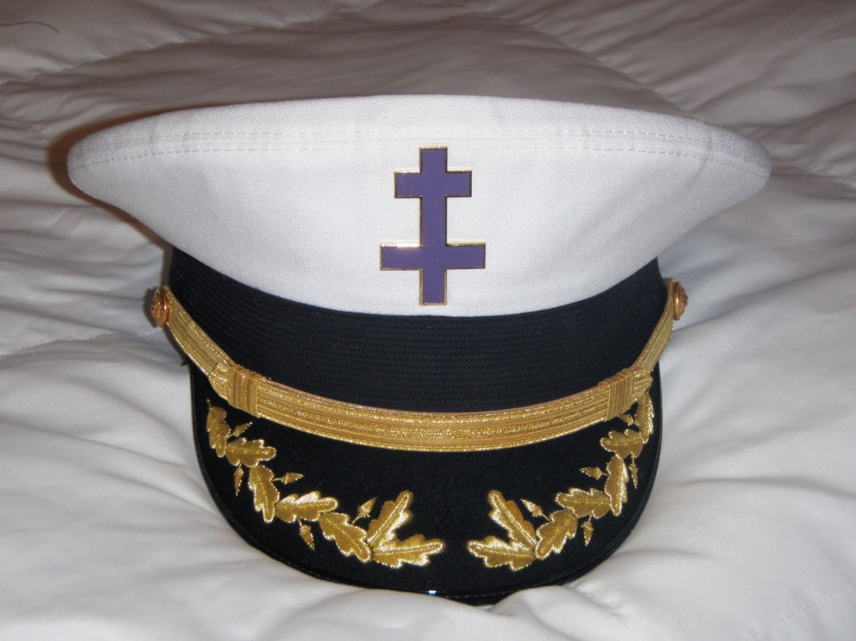
Uniforms
Pershing
Black or White top

Slide 24
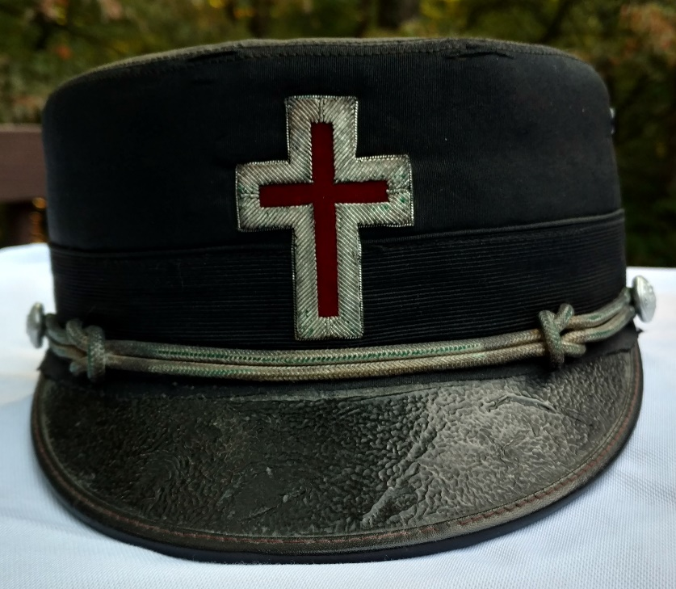
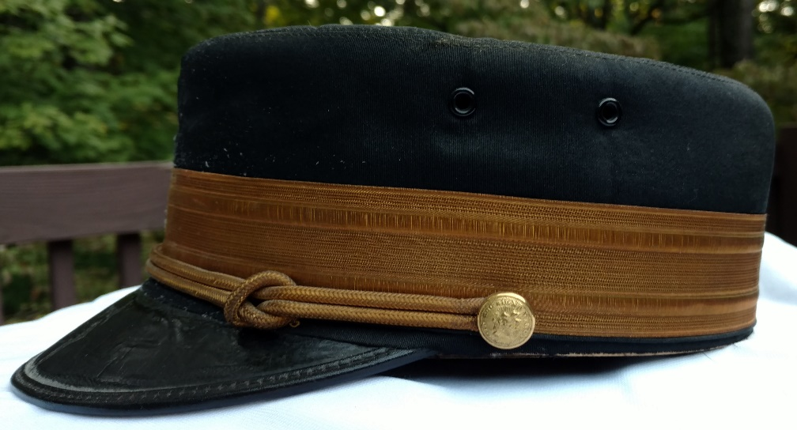
Uniforms
Bell Cap

Slide 25
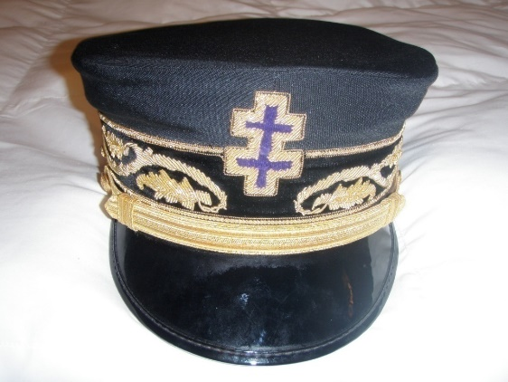
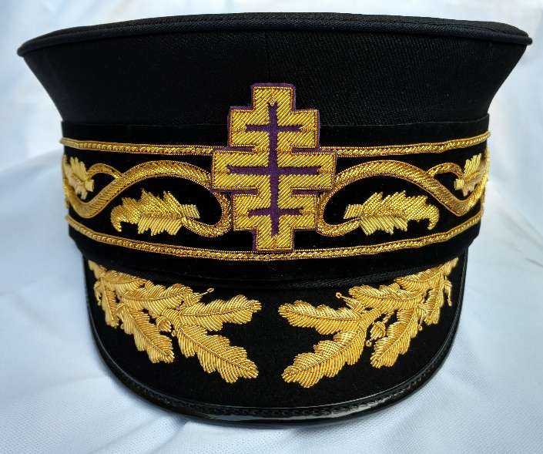
Uniforms
Bell – Only Elected Grand Encampment officers have decorated visor

Slide 26
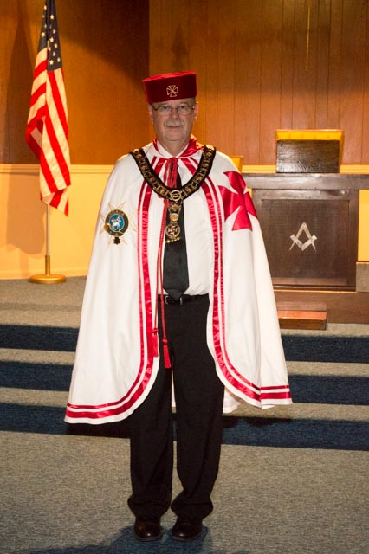
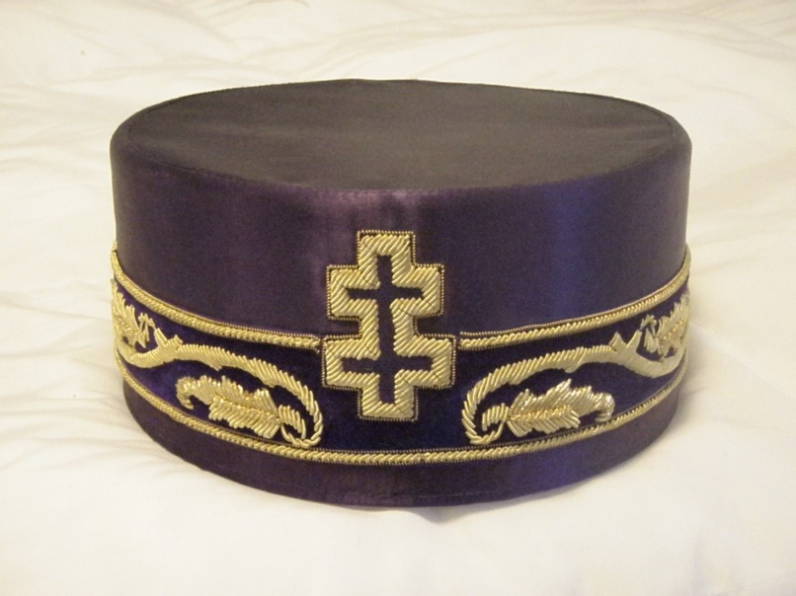
Uniforms
Cap and Mantle

Slide 27
Committees
Who Picks Grand Commandery Committees?
The Constitution of the GE Sec. 48b
Guarantees the GC the right to appoint all committees
The Grand Commandery may not take away
that right by mandating who may be on the
committee, or what term they may have.

Slide 28
Authority
The Grand Commander may exercise all authority given to him under Section 48 of the Constitution.
The powers and prerogatives of the Grand Commander are great but he is NOT the Grand Commandery when not in session.

Slide 29
Dispensations
Do NOT dispense with the statutes of Grand Encampment or of your Grand Commandery
Do NOT dispense with bylaws of a Commandery except in certain circumstances

Slide 30
Authority
Who may make someone a Templar at sight?
The Grand Master or his representative ONLY
Do NOT make a Templar at sight
Only the GM may do so

Slide 31
Annual Conclaves
Two Annual Conclaves of Grand Commanderies within the same Department may not conflict with each other.
Department Commanders are required to attend all and cannot be at two places at the same time
The GM may move the conclave of the offending Grand Commandery at it’s cost.

Slide 32
Discipline
Who may suspend a member?
Do NOT suspend or expel a Sir Knight for any reason
Only a trial commission may do that
You may remove an Officer from office

Slide 33
Discipline
DISCIPLINARY RULES
Section 209. In the conduct of all trials and all proceedings incident thereto, the Disciplinary rules adopted by the Grand Encampment shall be observed.
DISCIPLINARY RULES Consisting of Rules Referred to in Section 209 of the Grand Encampment Statutes TRIALS AND PUNISHMENTS OFFENSES

Slide 34
Discipline
Unless it is a charge specific to Templary, whenever possible, any charges should be referred to and trials conducted by the Grand Lodge of your jurisdiction.
If, for example, it is a criminal offense or un-Masonic conduct, one trial by the Grand Lodge will cover all Masonic Bodies in the jurisdiction.
It is cleaner and much more efficient.

Slide 35
Templar Law
Law updates
Grand Master Decisions

Slide 36
2015 LEGISLATION
Amended Section 258. Cap and Mantle
Mantle -- Authorized jewel of office to be worn suspended from a chain collar (Past Grand Commanders and Grand Commandery officers) or simple gold or silver color chain (constituent commanderies)

Slide 37
CHAIN COLLAR FOR GRAND COMMANDERY

Slide 38
CHAIN FOR CONSTITUENT COMMANDERY

Slide 39
The End

