Slide 1
Templar Law
What not to do as Grand Commander

Slide 2
Officers
Must a Grand Commandery Officer be a Past Commander?
Officers MUST be a member of the Grand Commandery
ie: Past Commander or Dais Officer
except Grand Prelate

Slide 3
KTCH
Who is eligible for the Knight Templar Cross of Honor?
A Sir Knight who has never held elective office in a Grand Commandery

Slide 4
KTCH
How are nominations for the Knight Templar Cross of Honor made?
Nominated by the Commandery
Approved by Grand Commander

Slide 5
KTCH
When should nominations for the Knight Templar Cross of Honor be made?
Recommend 60 days before Grand Conclave

Slide 6
KTCH
How many KTCH awards may a Grand Commandery make each year?
One (1) + an additional for each 5,000 members or major fraction thereof
3,000 members = 2 awards

Slide 7
Performing Ritual
May a man who is not a Knight Templar participate in a tiled opening?
No
Why is this even a question

Slide 8
Jewels
Where may jewels be worn on the uniform?
Section 301. Only Templar Jewels are to be worn on the Templar Uniform. Jewels of office, meritorious jewels, badge of Commanderies, Malta and Red Cross jewel may be worn on the left breast, placed in the order named, from the wearer's right to left. (1985, p. 75-80)

Slide 9
Jewels
What makes a Jewel a Templar Jewel?
Only Templar jewels may be worn on a Templar uniform and it is presumed that a Grand Commandery has ruled correctly on individual jewels unless found otherwise. A Drill Corps badge qualifies as a Templar Jewel. The authority of different Grand Commanderies to govern their jurisdictions permits differences to occur. (1925, p 73 & 402, No. 21, Newby)

Slide 10
Jewels
So the Grand Commandery can make any jewel official?
A Grand Commander is in error to request that Sir Knights wear Victory or Official Military Service Badges. (1937, p 28 & 327, No. 11, Agnew,)

Slide 11
Jewels
Did the Grand Commander in the prior slide do anything else?
A first prize medal awarded by Ohio State University is not a Templar Jewel. (1937, p 27 & 325, No. 9, Agnew)

Slide 12
Jewels
What can go on the right side of the uniform?
Name plate
Knight Templar Eye Foundation badge
Grand Encampment committee badge
Triennial badge (during the session)

Slide 13
Jewels
What jewels can go around the neck? KYCH?
The statutes provide that certain officers may wear a jewel suspended from a cord around the neck, but they do not provide for this kind of jewel. (KYCH) (1961, p. 50, No. 23, Wieber)

Slide 14
Jewels
What jewels can go around the neck?
Section 302. The Jewels of Office of the Grand Master and other current Officers of the Grand Encampment shall be worn suspended from a heavy royal purple silk cord with swivel

Slide 15
Jewels
What jewels can go around the neck?
Section 306. (a) The Jewel of Office of Grand Commanders may be worn suspended from a heavy, red, silk cord with swivel; the cord to have a tassel at the ends to be held together by sliding holders with rosette; the cord to have a total length of sixty-four inches. (1967, p. 89-91)

Slide 16
Jewels
What jewels can go around the neck?
Sec 237B (a) The following items shall be presented to the recipients of the "Knights Templar Cross of Honor". An award consisting of a gold medal upon the center of which shall be a Patriarchal Cross in purple. Around the cross shall be inscribed the words "Knights Templar Cross of Honor." The metal shall be suspended on a red neck ribbon.

Slide 17
Uniforms
What are the 5 styles of uniform in a Grand Commandery?
Regulation Uniform
Cap and Mantle
Summer Uniform
Ceremonial Uniform
Fatigue Uniform

Slide 18
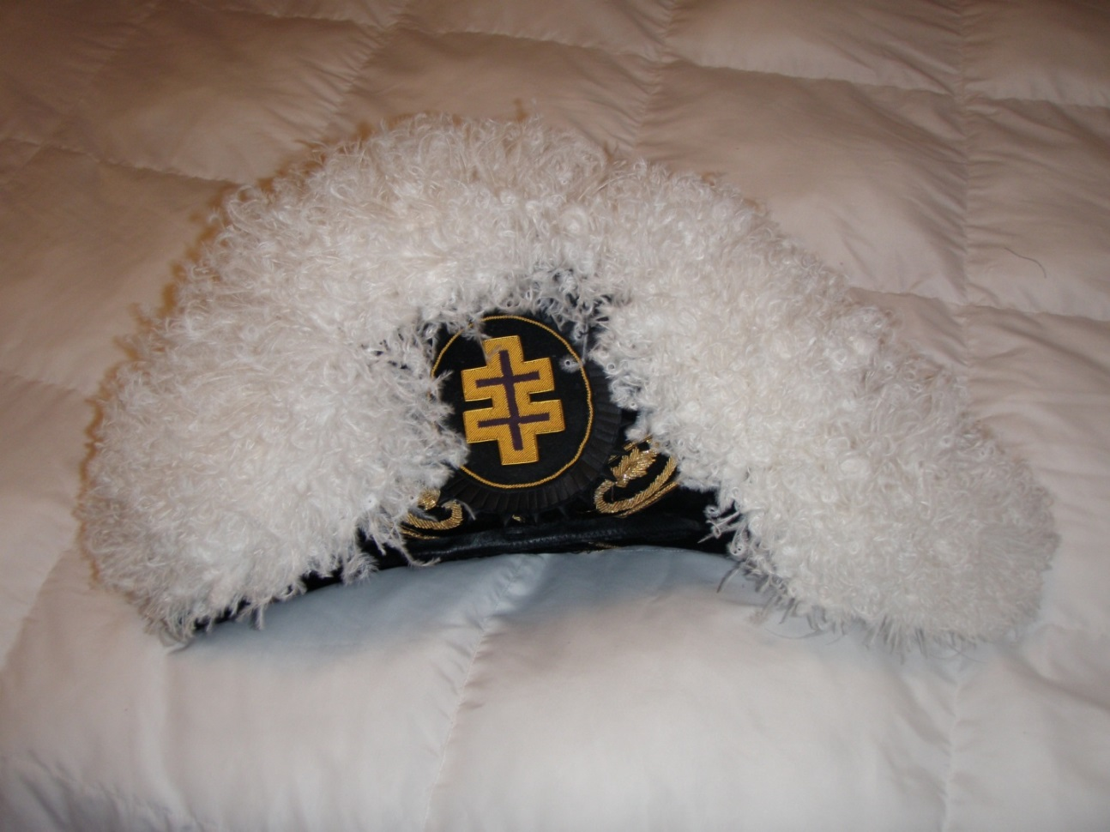
Uniforms
Standard Chapeau

Slide 19
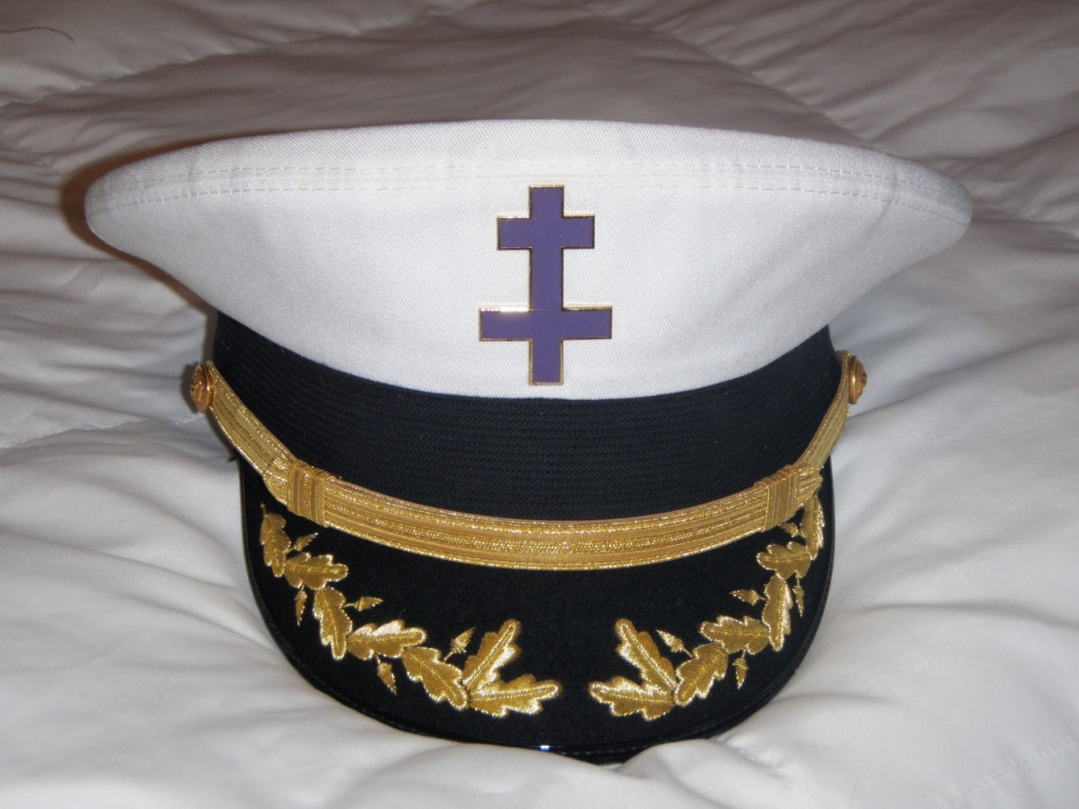
Uniforms
Pershing
Black or White top

Slide 20
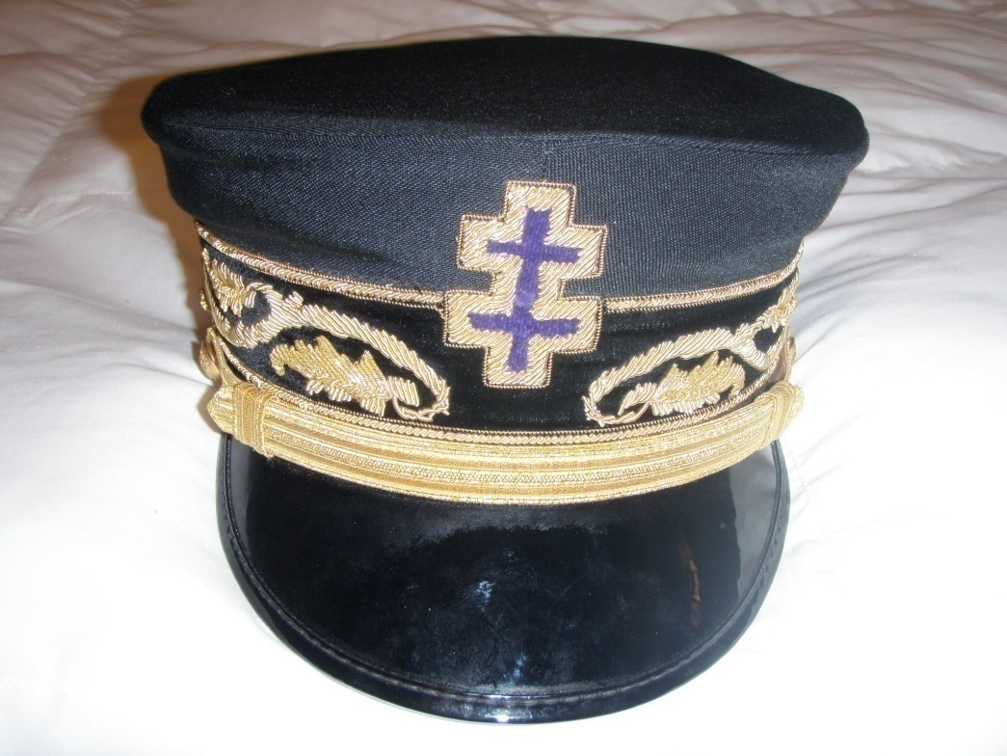
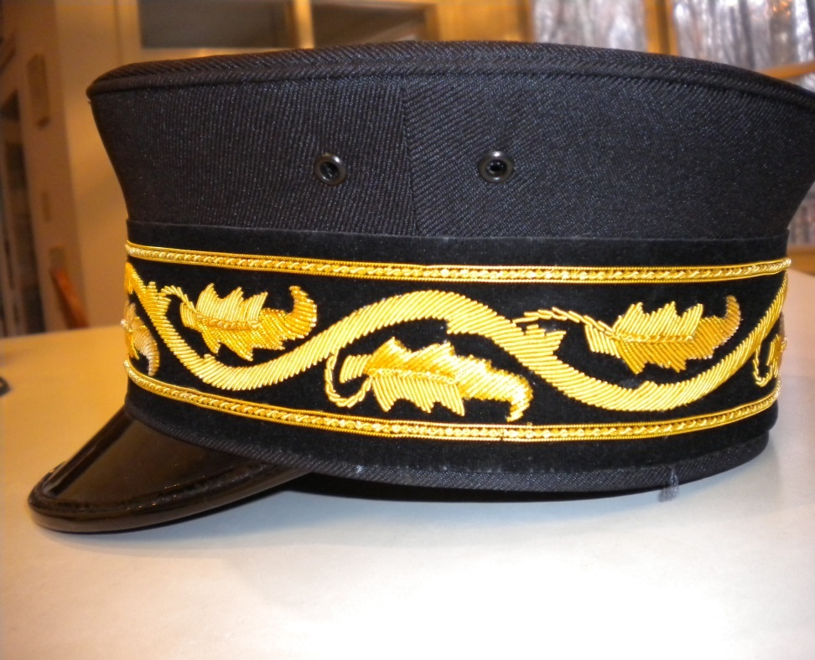
Uniforms
Bell – Only Grand Encampment can have decorated visor

Slide 21
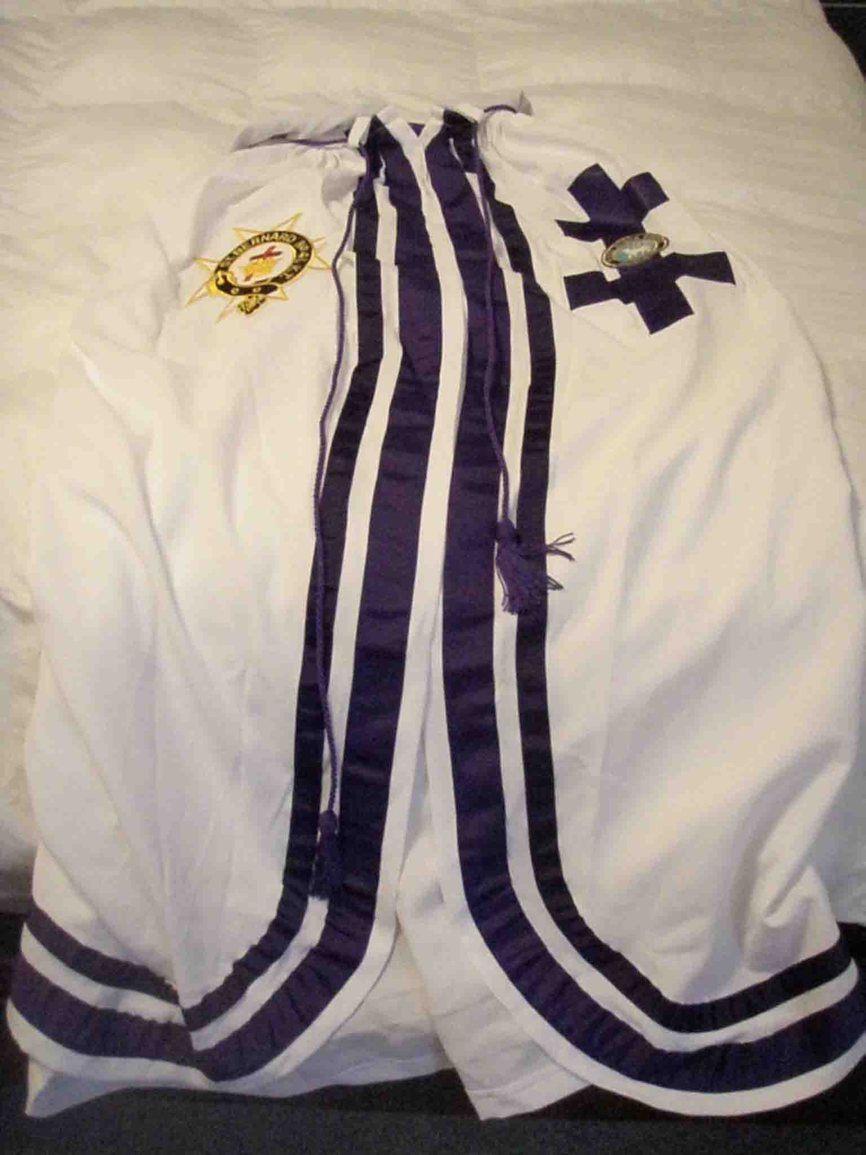
Uniforms
Cap and Mantle

Slide 22
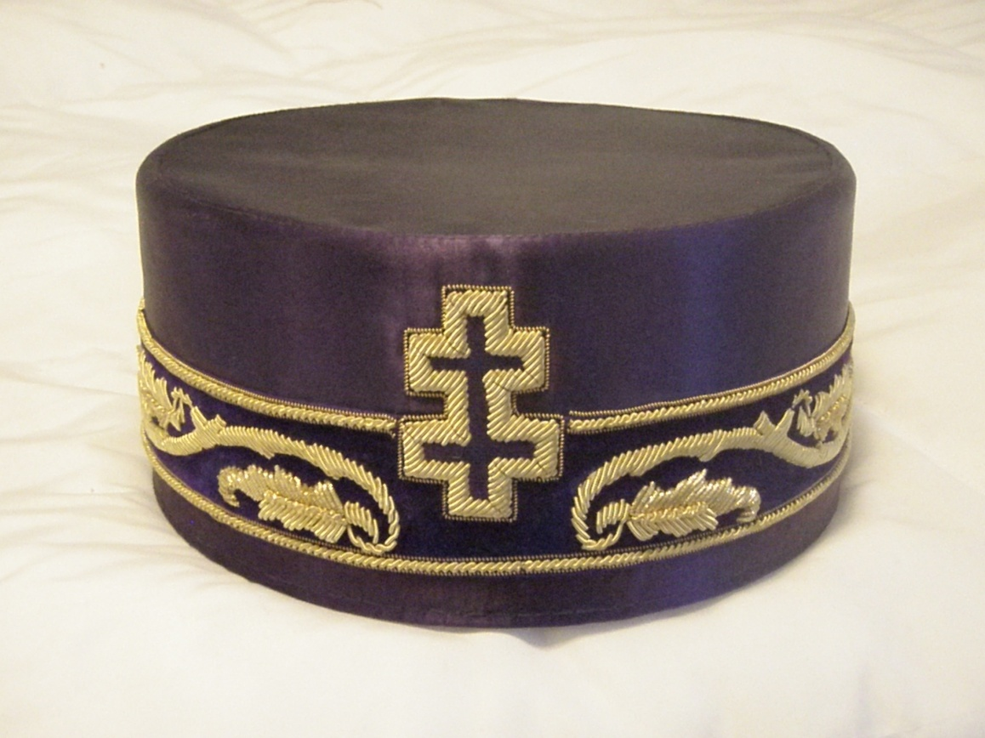
Uniforms
Cap and Mantle

Slide 23
Honorary Title
Honorary Titles? What? How?

Slide 24
Honorary Titles
Section 237(a). Honorary titles may be conferred upon Sir Knights who have rendered long, outstanding and distinguished service in the cause of Templary in conformity with the provisions hereof. No titles of office, whether active or honorary, shall be conferred by any Grand Commandery, or any Constituent or Subordinate Commandery, except the title of active officers named in, or authorized by, the Constitution of the Grand Encampment, or honorary titles as authorized in this section. Each Grand Commandery, each Constituent Commandery and each Subordinate Commandery, shall have the right, in conformity to the provisions of this section to confer honorary titles as follows:

Slide 25
Honorary Titles
(b) Commanderies, whether Constituent or Subordinate, may confer the honorary titles of Honorary Past Commander, Captain General Emeritus, Treasurer Emeritus, Recorder Emeritus, and Prelate Emeritus upon written approval of the Grand Master in the case of Subordinate Commanderies and written approval of the Grand Commander of the respective Jurisdiction in the case of Constituent Commanderies;

Slide 26
Honorary Titles
What about Grand Commanderies?

Slide 27
Honorary Titles
(a) Grand Commanderies may confer the honorary titles of Honorary Past Grand Commander, Grand Treasurer Emeritus, Grand Recorder Emeritus, and Grand Prelate Emeritus upon written approval of the Grand Master;

Slide 28
Honorary Titles
(a) Grand Commanderies may confer the honorary titles of Honorary Past Grand Commander, Grand Treasurer Emeritus, Grand Recorder Emeritus, and Grand Prelate Emeritus upon written approval of the Grand Master;

Slide 29
Honorary Titles
DO NOT BRING THIS UP IN SESSION UNLESS IT HAS BEEN APPROVED IN ADVANCE

Slide 30
Committees
Who Picks Grand Commandery Committees?
The Constitution of the GE Sec. 48b
Guarantees the GC the right to appoint all committees
The Grand Commandery may not take away
that right by mandating who may be on the
committee, or what term they may have.

Slide 31
Authority
The Grand Commander may exercise all authority given to him under Section 48 of the Constitution.
The powers and prerogatives of the Grand Commander are great but he is NOT the Grand Commandery when not in session.

Slide 32
Dispensations
Do NOT dispense with the Constitutional number of nine Sir Knights for a Conclave

Slide 33
Dispensations
Do NOT dispense with the statutes of Grand Encampment or of your Grand Commandery
Do NOT dispense with bylaws of a Commandery except in certain circumstances

Slide 34
Authority
Who may make someone a Templar at sight?
The Grand Master or his representative ONLY
Do NOT make a Templar at sight
Only the GM may do so

Slide 35
Conferal of Orders
May we confer the orders by watching a DVD?
NO
Video tape, DVD or any other form of video presentation of the Orders of Templary as depicted in the rituals of the Grand Encampment are not to be used in the conferral of said orders. They were produced for instructional purposes only. The conferral of any Order must be done by Sir Knights, in a Commandery Asylum. (2006, p. 69 & 151, No. 3, Fischer)

Slide 36
Annual Conclaves
There will be no two Annual Conclaves of Grand Commanderies within a Department that conflict with each other.
Department Commander are required to attend all and cannot be at two places at the same time
The GM will move the conclave of the offending Grand Commandery

Slide 37
Discipline
Who may suspend a member?
Do NOT suspend or expel a Sir Knight for any reason
Only a trial commission may do that
You may remove an Officer from office

Slide 38
Discipline
DISCIPLINARY RULES
Section 209. In the conduct of all trials and all proceedings incident thereto, the Disciplinary rules adopted by the Grand Encampment shall be observed.
DISCIPLINARY RULES Consisting of Rules Referred to in Section 209 of the Grand Encampment Statutes TRIALS AND PUNISHMENTS OFFENSES

Slide 39
Discipline
Unless it is a charge specific to Templary, whenever possible, any charges should be referred to and trials conducted by the Grand Lodge of your jurisdiction.
If, for example, it is a criminal offense or un-Masonic conduct, one trial by the Grand Lodge will cover all Masonic Bodies in the jurisdiction.
It is cleaner and much more efficient.

Slide 40
The End

